Slide 1
GAMES DESIGN DOCUMENT (ART BIBLE)
Group members:
Will Foster (code)
Madeleine Coffey (3D/2D)
Callum Guyer (2D/3D)
Harry Rowland (2D/3D)

Slide 2
Initial idea:
Girl using umbrella to slowly drift down.
2.5 D Runner
Art styles to look at silhouette or cardboard.
Weather effects – is it raining? Girl in a storm perhaps.
Real or a dream?
Failing is hitting the ground.

Slide 3


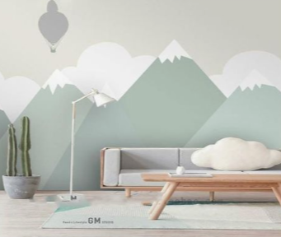
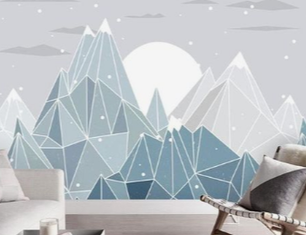


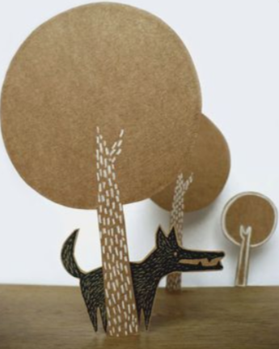
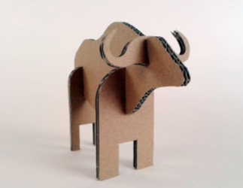
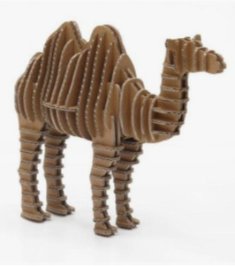

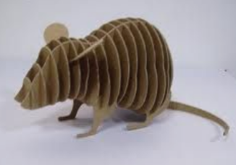


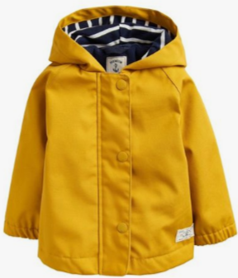
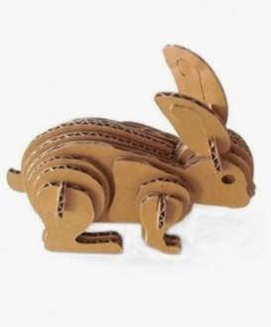
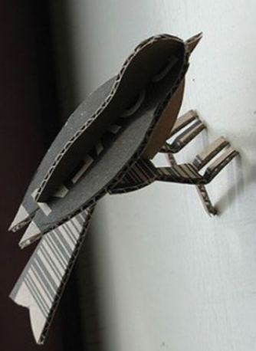
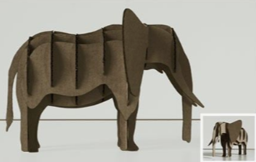
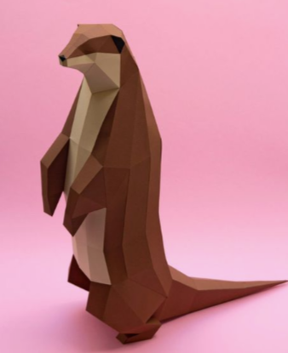



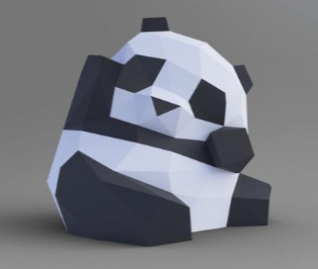
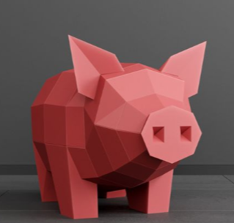
MOOD BOARDS
https://www.pinterest.co.uk/coffeym7204/year-2-game-mood-boards/

Slide 4
Insert one sheet here

Slide 5
Insert character concept here

Slide 6
Insert background concept here

Slide 7

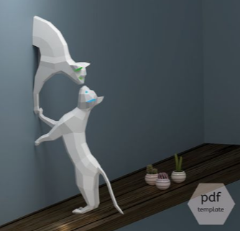
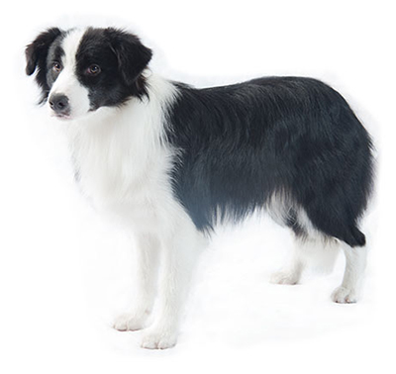
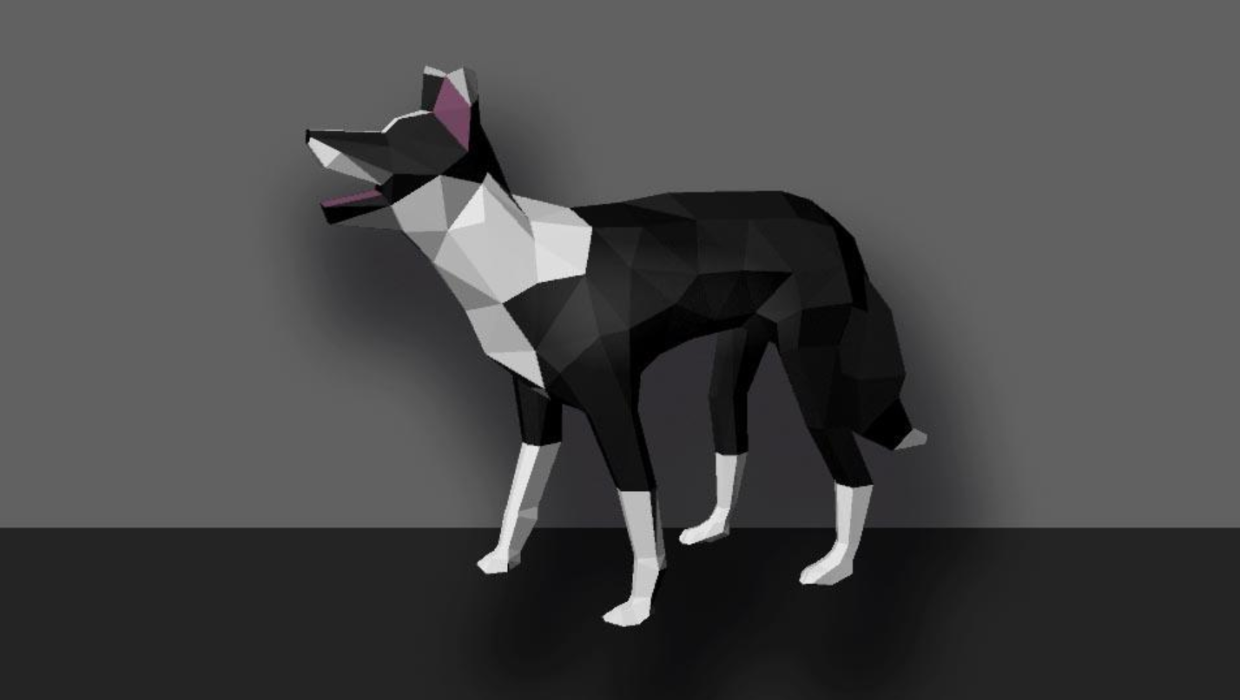

3D model experiments
Inspiration:
52 poly umbrella, took about 10 minutes to make
Border Collie, around 800 poly which is way to high for the game, will be less if we don’t triangulate the models. A lot of the polys were in the paws and the face, so rethinking those should take the poly count right down. Took about 4 hours.

Slide 8
Insert early unity grey box prototype here

